Slide 1
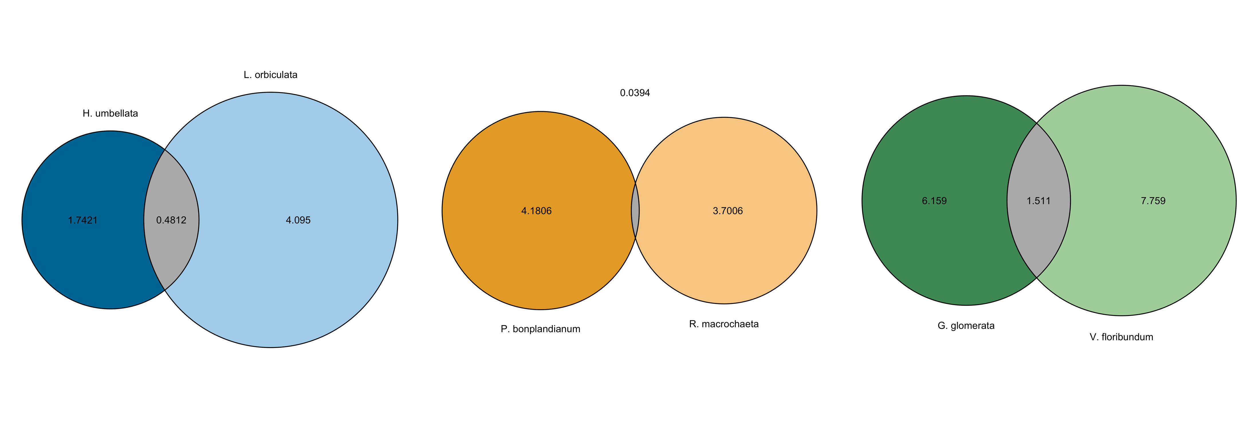
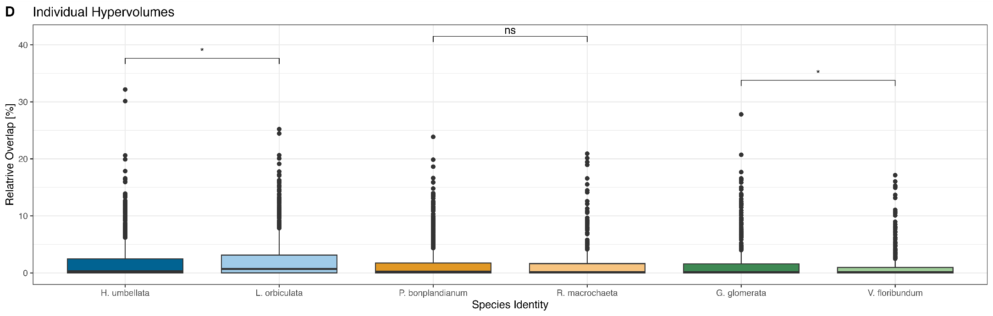
6.21%
Forb vs. Woody
1.71%
4.96%
Gramminoid vs. Woody
Forb vs. Gramminoid

